Slide 1
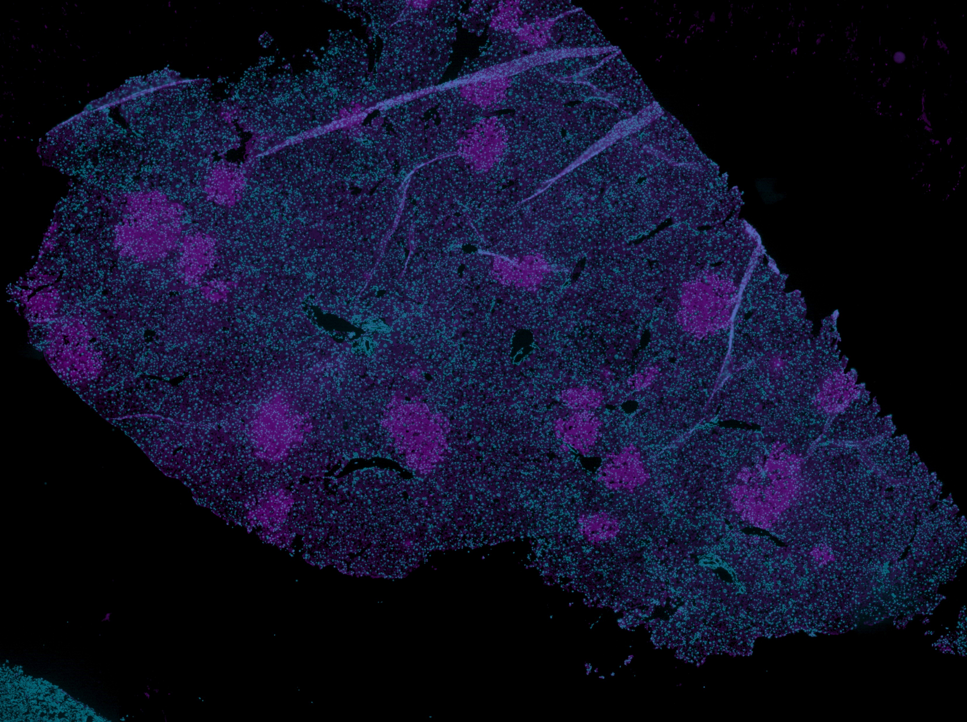


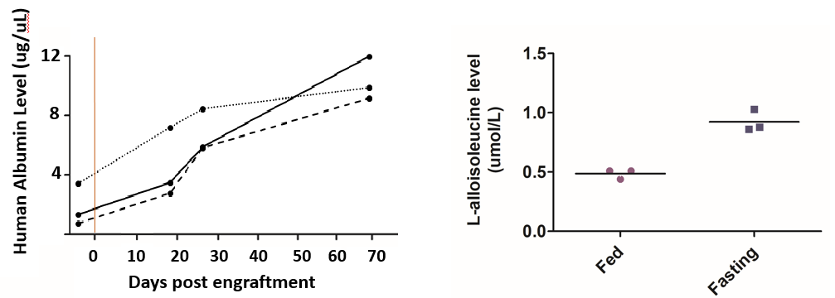
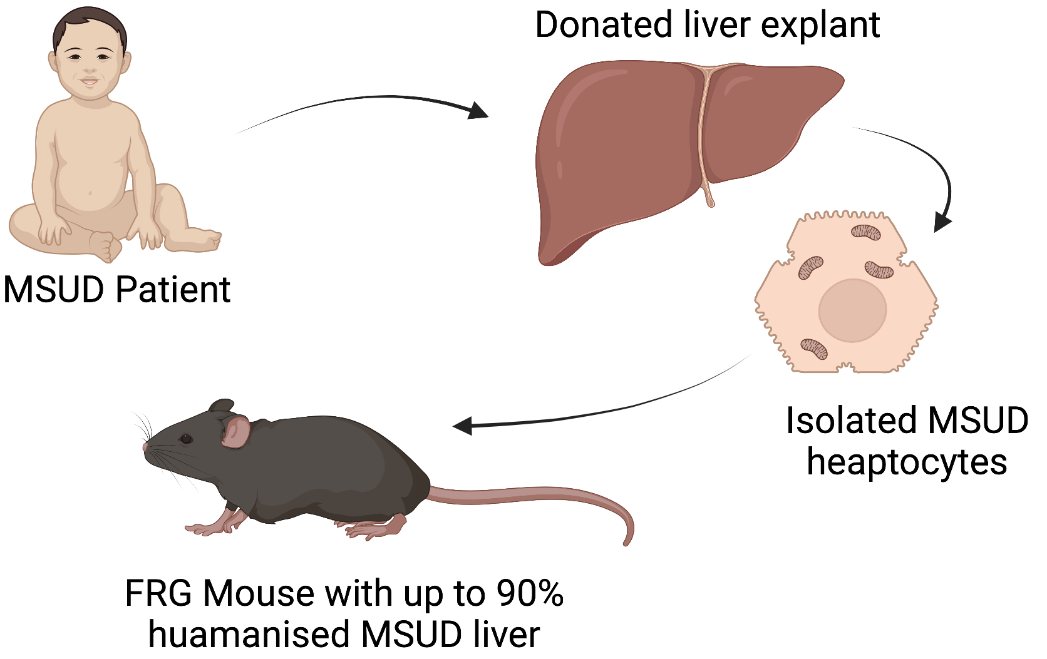
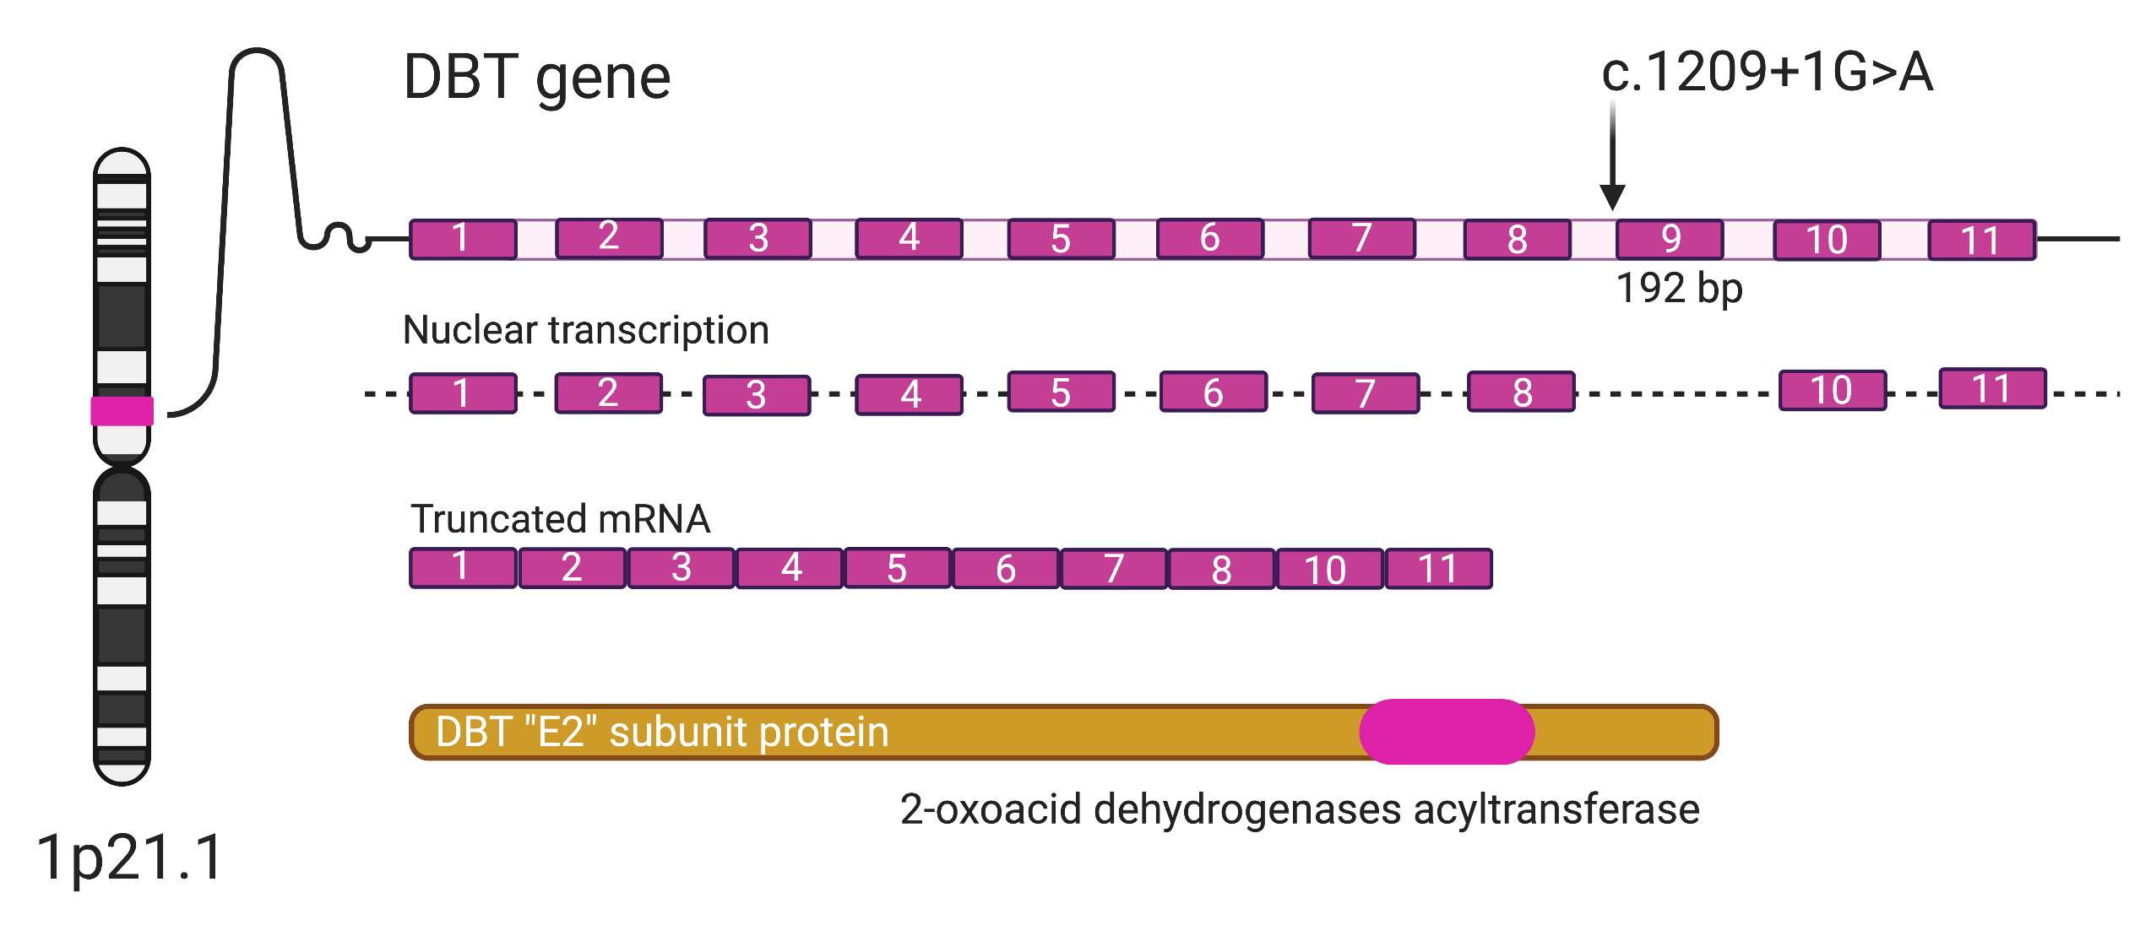
Humanised Disease Model for Maple Syrup Urine Disease
Kathryn Mullany^{1,2}, Susan Siew^{1,2}, Ian Alexander^{1,2}
1. Gene Therapy Research Unit, The Children’s Medical Research Institute
2. The Children’s Hospital at Westmead
A B
INTRODUCTION
Maple Syrup Urine Disease (MSUD) is a rare, autosomal recessive genetic condition caused by deficiency in branched chain ketoacid dehydrogenase (BCKDH). There are three main genotypes, BCKDHA, BCKDHB and DBT (1). Currently there is no cure for MSUD and patients rely on strict dietary protein restriction or liver transplantation to manage their disease. There is one existing MSUD animal model, a DBT knock out murine model (2) however no humanized disease models. The FRG (Fah^{-/-}/Rag2^{-/-}/Il2rg^{-/-}) mouse is a transgenic mouse which allows for the expansion of human hepatocytes under dietary NTBC withdrawal (3). In this way, the FRG mouse can be used to generate disease models and test potential therapies in vivo.
Figure 4. A. Human albumin concertation in FRG mice engrafted with human MSUD affected hepatocytes. Rising human albumin levels reflect expanding human hepatocyte numbers with maximal engraftment at approximately 90%. B. Elevation in L-alloisoleucine level in FRG hMSUD when in catabolic physiological state at 60% engraftement.
METHODS
Human MSUD affected hepatocytes were obtained through our collaboration with the Australian Liver Transplant program at The Children’s Hospital at Westmead. Genomic mRNA was extracted and utilized to characterize the MSUD genotype. FRG mice were injected with 10^6 human hepatocytes and exposed to a standard NTBC withdrawal cycle (2).
kD
MSUD Patient
DBT +/+
120
Viculin
Figure 2. Humanised mouse model of MSUD. Donated explant liver is processed to isolate and preserve MSUD affected hepatocyte and then injected into FRG mice.
50
DBT
RESULTS
Protein gradient
Figure 5. Western Blot analysis of DBT protein in MSUD patient sample and a normal human liver. DBT protein (~54kD) was partially purified from liver lysates and a gradient amount loaded for each sample (4). Samples were normalised to Vinculin (117kD).
A
Wild Type Cells
MSUD patient
Positive control
1500 bp
B
FUTURE DIRECTIONS
We have characterised a novel disease causing mutation of MSUD and have demonstrated that these hepatocytes are viable in the transgenic FRG mouse. We have commenced FRG MSUD phenotype characterization and hope to use this mouse model to test novel genetic therapies for MSUD.
Figure 3. A. DBT gene size discrepancy between wildtype cDNA (Huh7 cell line) and MSUD patient cDNA (MSUD Liver) isolated with gel electrophoresis B. Sanger sequencing of MSUD patient cDNA across DBT exon 8 to exon 10 demonstrates absence of exon 9.
Figure 1. Next generation genomic sequencing of the MSUD gene revealed a novel mutation in the DBT gene (1p21.1 [c.1209+1G>A]). This insertional mutation was predicted to disrupt the splice site of exon 9, resulting in truncated mRNA and protein with major catalytic domain disruption.
1. Strauss KA, P.E., Carson VJ. , Maple Syrup Urine Disease. Gene Reviews, ed. A.H. Adam MP, Pagon RA, et al., editors. 2006, Seattle: University of Washington.
2. Homanics, G.E., et al., Production and characterization of murine models of classic and intermediate maple syrup urine disease. BMC medical genetics, 2006. 7: p. 33-33.
3. Azuma, H., et al., Robust expansion of human hepatocytes in Fah-/-/Rag2-/-/Il2rg-/- mice. Nature biotechnology, 2007. 25(8): p. 903-910.
4. Paul, H.S. and S.A. Adibi, Mechanism of activation of hepatic branched-chain alpha-ketoacid dehydrogenase by a muscle factor. Journal of Biological Chemistry,
1983. 258(19): p. 11471-11475.

